Slide 1
TELECOM NETWORK
QUALITY ANALYTICS
Team members: Yash Desai
      Shreya Mane
      Moneshwaran
      Dommaraju Chaithrika
      Jenifer Thangam
End-to-end Azure Databricks data platform
Bronze • Silver • Gold | Dashboard | Genie
Project: Capstone 6

Slide 2
1. Problem Statement
TELECOM NETWORK QUALITY
Telecom network data is fragmented across multiple sources, making it difficult to accurately monitor network quality, outages, and customer impact. The project aims to build a governed Databricks Pipeline that delivers reliable, traceable, and analytics-ready data for faster operational insights.

Slide 3
2. Proposed Solution
TELECOM NETWORK QUALITY
Implement a Bronze → Silver → Gold Medallion Architecture to ingest, validate, transform, and analyze network, outage, and customer complaint data for accurate KPI monitoring and faster decision-making.
3. Objective
Build a governed Databricks Lakehouse to integrate telecom data and provide reliable, traceable, and analytics-ready insights.

Slide 4
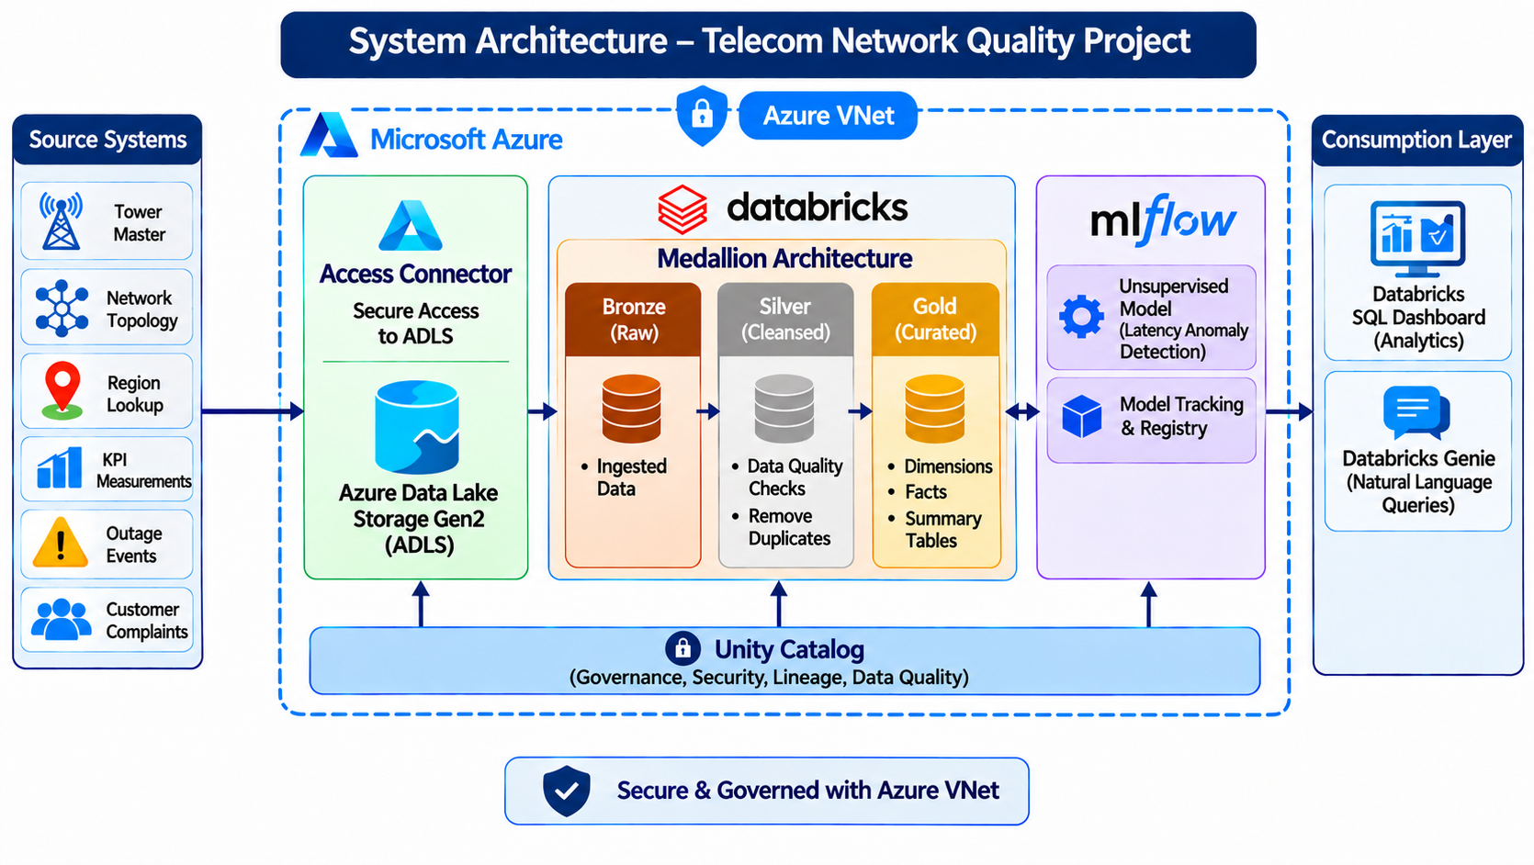
3. System Architecture
TELECOM NETWORK QUALITY

Slide 5
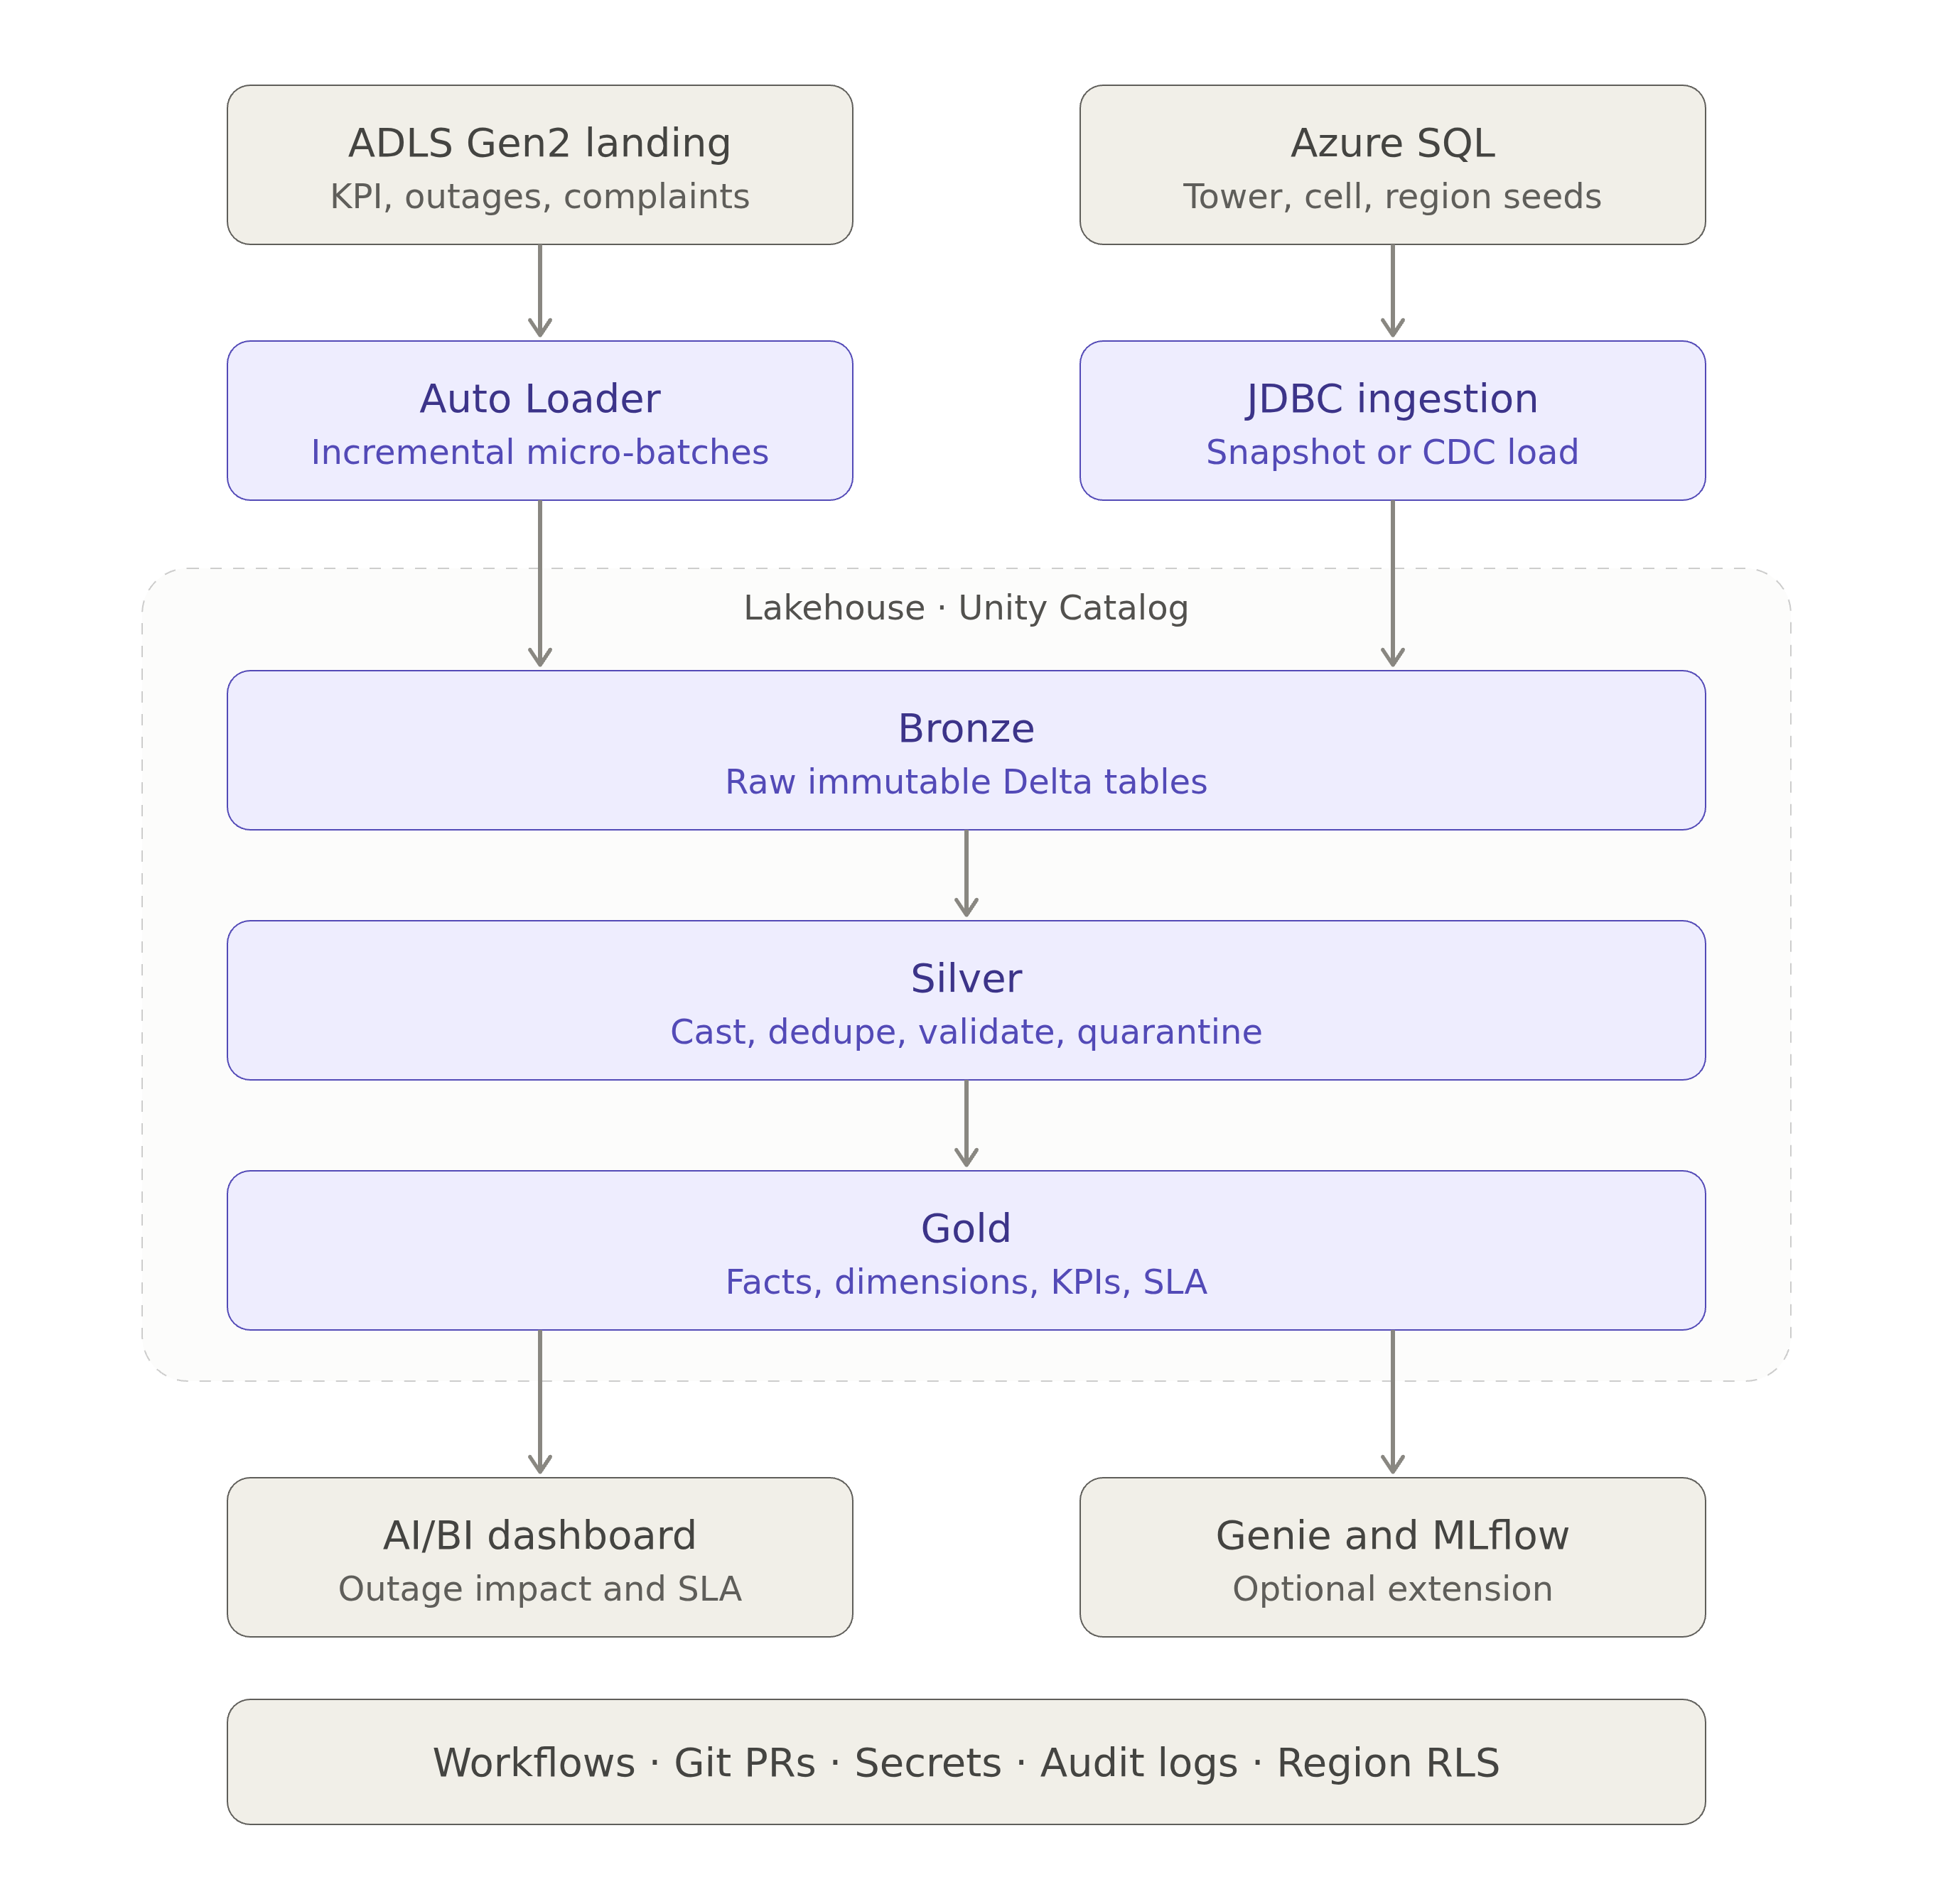
3. System Architecture — High-Level Design (HLD)
TELECOM NETWORK QUALITY

Slide 6
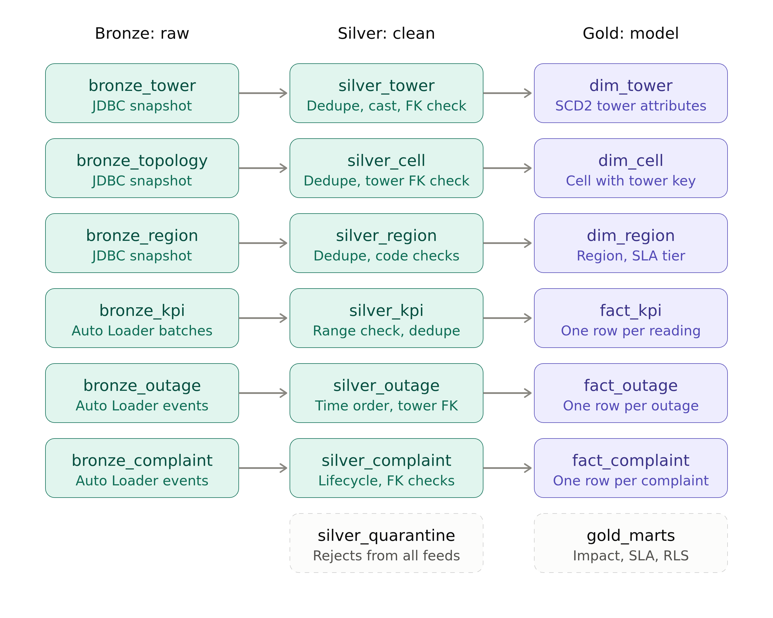
3. System Architecture — Low-Level Design (LLD)
TELECOM NETWORK QUALITY

Slide 7
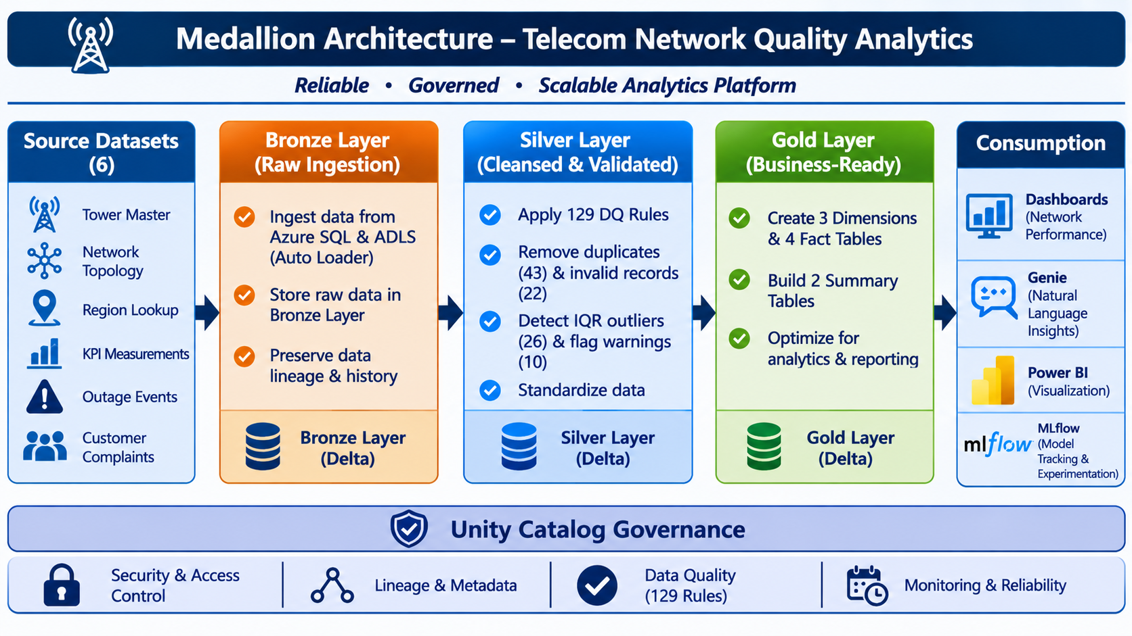
4. Medallion Architecture
TELECOM NETWORK QUALITY

Slide 8
5. Workflow Diagram
TELECOM NETWORK QUALITY
1. INGEST
Azure SQL via JDBC
ADLS Gen2 via Auto Loader
2. BRONZE
Land raw source records
with ingestion metadata
3. SILVER
Apply cleaning, deduplication
and 129 quality rules
4. GOLD
Build 3 dimensions,
4 facts and 2 summaries
5. VALIDATE
117 layer checks
+ 43 regression checks
6. USE INSIGHTS
SQL Dashboard
Genie natural-language Q&A
QUALITY RECONCILIATION
11,894 KPI rows − 43 exact duplicates − 22 invalid latency rows = 11,829 clean KPI records
IQR outliers are flagged for review and retained as warnings; this project does not claim a trained ML model.

Slide 9
6. Dataset Specifications & Profiling
TELECOM NETWORK QUALITY
Six telecom datasets were reviewed to understand their structure and data quality before processing.
6 DATASETS
13,454
Azure SQL + ADLS Gen2
Total source records
DATASET SPECIFICATIONS
DATA PROFILING
Master data
tower_master
network_topology_master
region_lookup
1
Reviewed record counts, columns and data types.
Network data
network_kpi_measurements
2
Checked missing values and duplicate records.
3
Identified invalid values and potential outliers.
Event data
network_outage_events
4
Used findings to guide Silver-layer cleaning and validation.
Customer data
customer_complaints

Slide 10
7. Data Ingestion from Landing Zone
TELECOM NETWORK QUALITY
ADLS GEN2
AUTO LOADER
BRONZE DELTA
METADATA
ext_raw_landing
CSV file feeds
cloudFiles discovery
Incremental file processing
3 file-feed tables
Append new arrivals
Checkpoint + schema
Audit and rescued data
• Checkpoint tracks processed-file progress.
• Schema metadata is stored separately from the landing volume.
• Schema evolution mode is configured as rescue.
• Use a new filename when delivering a corrected file.
• Audit fields: _source_system, _source_feed, _source_file, _ingested_at.
• Unexpected fields can be retained in _rescued_data.
• Azure SQL master feeds use JDBC separately.
• Credentials are read from azure-sql-scope.

Slide 11
8. Bronze Layer — Raw Data Storage
TELECOM NETWORK QUALITY
Azure SQL → Bronze
ADLS → Bronze
Profiling
bronze_tower_master
bronze_network_topology_master
bronze_region_lookup
bronze_network_kpi_measurements
bronze_network_outage_events
bronze_customer_complaints
bronze_profiling_summary
Nulls • duplicates • categories
Numeric ranges
Bronze baseline row counts
161
170
179
11,894
696
354
Towers
Cells
Regions
KPI
Outages
Complaints

Slide 12
9. Silver Layer — Cleaning & Data Quality
TELECOM NETWORK QUALITY
43
22
26
10
Exact duplicate KPI copies
Invalid negative latency rows
IQR outliers — retained
Missing optional fields — retained
KPI row reconciliation
Handling decision
Stage | Rows
Bronze KPI measurements | 11,894
Rejected: exact duplicates | (43)
Rejected: negative latency | (22)
Silver KPI measurements | 11,829
REJECT — 65
WARN — 36
Excluded from clean Silver; original record and reason retained in silver_rejected_records.
Remain in Silver with dq_warning_checks and traceability in silver_warning_records.

Slide 13
10. Gold Layer — Business Data Model
TELECOM NETWORK QUALITY
3 dimensions
4 fact tables
2 summaries
Table | Grain / rows
dim_tower | 1 per tower • 161
dim_cell | 1 per cell • 170
dim_region | 1 per region • 179
Table | Grain / rows
fact_network_kpi | 1 per measurement • 11,829
fact_network_outage | 1 per outage • 696
fact_customer_complaint | 1 per complaint • 354
fact_outage_impact | 1 per outage • 696
Table | Grain / rows
gold_network_quality_daily | 1 per region/day • 3,998
gold_region_sla_summary | 1 per region • 179

Slide 14
11. Dashboard — Network Quality Overview
TELECOM NETWORK QUALITY
97.50%
84.58 ms
2.48%
Availability
Average latency*
Packet loss
696
354
3,480 min
Outages
Complaints
Outage duration
Filters
Charts
Pipeline health
Date range and SLA tier (BRONZE / SILVER)
Daily latency trend; availability by tier / region; outage type and severity
Bronze 28 + Silver 41 + Gold 48 = 117 validation checks

Slide 15
13. Challenges & Key Observations
TELECOM NETWORK QUALITY
Challenge / observation | Documented result | Handling / interpretation
Duplicate KPI rows | 43 exact duplicate copies | Reject duplicates to avoid double counting
Invalid latency | 22 negative placeholders (-999) | Reject and retain reason / traceability
Unusual KPI values | 26 IQR outlier findings | Warn and retain; exclude from primary latency average
Missing optional fields | 10 findings | Warn; retain usable records
Outage correlation | 145 with telemetry; 51 with complaint evidence | Time/tower correlation; not proof of causation
SLA interpretation | BRONZE 97.50%; SILVER 97.51% | No pass/fail without agreed tier targets

Slide 16
14. Future Enhancements
TELECOM NETWORK QUALITY
Governance
SLA thresholds
Data quality
Implement regional row-level access after mapping users to regions.
Agree business-approved availability and latency targets for each tier.
Add late-arrival, interval-gap and complaint-status consistency checks.
Formal UAT
Advanced analytics
Operations
Complete business owner, data engineering and QA sign-offs.
Evaluate forecasting / anomaly models with labelled data and model validation.
Add alerts, trend monitoring, cost and performance tracking, and feed SLAs.

Slide 17
Thank You
CAPSTONE PROJECT
Team: Add names | Contact: Add email

